Slide 1
ARM Processors and Architectures
A Comprehensive Overview
ARM University Program
September 2012
Notes:
<number>

Slide 2
Agenda
Introduction
ARM Architecture Overview
ARMv7-AR Architecture
Programmer’s Model
Memory Systems
ARMv7-M Architecture
Programmer’s Model
Memory Systems
Floating Point Extensions
ARM System Design
Software Development Tools
Notes:
<number>

Slide 3
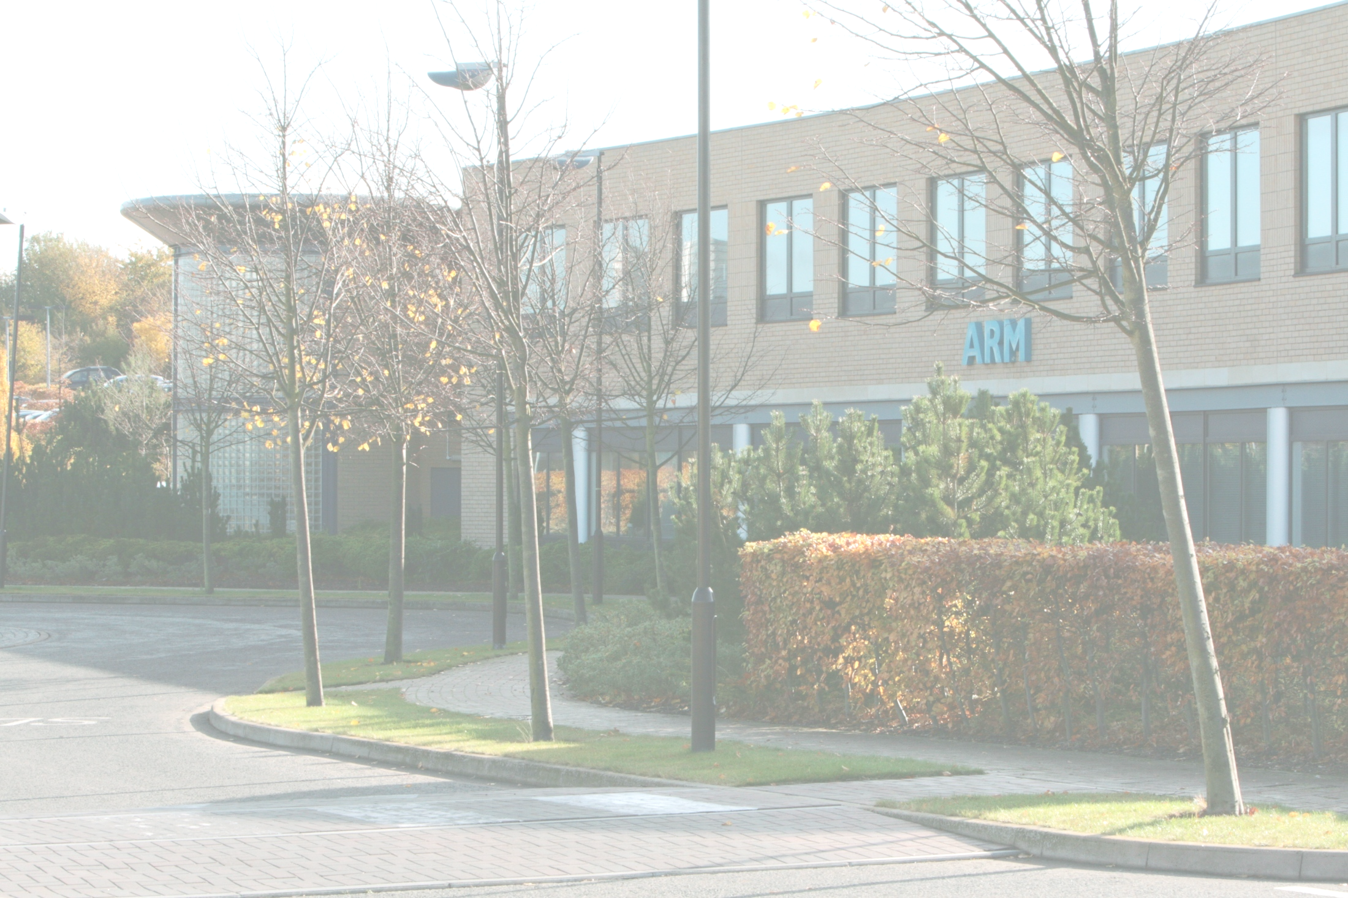
ARM Ltd
ARM founded in November 1990
Advanced RISC Machines
Company headquarters in Cambridge, UK
Processor design centers in Cambridge, Austin, and Sophia Antipolis
Sales, support, and engineering offices all over the world
Best known for its range of RISC processor cores designs
Other products – fabric IP, software tools, models, cell libraries - to help partners develop and ship ARM-based SoCs
ARM does not manufacture silicon
More information about ARM and our offices on our web site:
http://www.arm.com/aboutarm/

Slide 4

ARM Offices Worldwide

Slide 5

ARM Connected Community – 900+
Connect, Collaborate, Create – accelerating innovation
Notes:
<number>

Slide 6
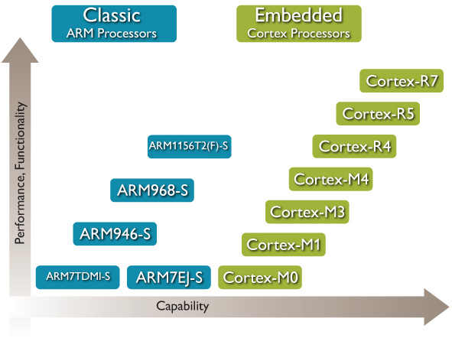
Embedded Processors

Slide 7
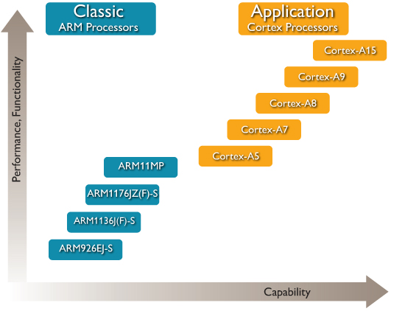
Application Processors
Notes:
<number>

Slide 8
Agenda
Introduction
ARM Architecture Overview
ARMv7-AR Architecture
Programmer’s Model
Memory Systems
ARMv7-M Architecture
Programmer’s Model
Memory Systems
Floating Point Extensions
ARM System Design
Software Development Tools
Notes:
<number>

Slide 9
Development of the ARM Architecture
v4
v5
v6
v7
Halfword and signed halfword / byte support
System mode
Thumb instruction set (v4T)
Improved interworking
CLZ
Saturated arithmetic
DSP MAC instructions
Extensions:
Jazelle (5TEJ)
SIMD Instructions
Multi-processing
v6 Memory architecture
Unaligned data support
Extensions:
Thumb-2 (6T2)
TrustZone® (6Z)
Multicore (6K)
Thumb only (6-M)
Thumb-2
Architecture Profiles
7-A - Applications
7-R - Real-time
7-M - Microcontroller
Note that implementations of the same architecture can be different
Cortex-A8 - architecture v7-A, with a 13-stage pipeline
Cortex-A9 - architecture v7-A, with an 8-stage pipeline

Slide 10
Architecture ARMv7 profiles
Application profile (ARMv7-A)
Memory management support (MMU)
Highest performance at low power
Influenced by multi-tasking OS system requirements
TrustZone and Jazelle-RCT for a safe, extensible system
e.g. Cortex-A5, Cortex-A9
Real-time profile (ARMv7-R)
Protected memory (MPU)
Low latency and predictability ‘real-time’ needs
Evolutionary path for traditional embedded business
e.g. Cortex-R4
Microcontroller profile (ARMv7-M, ARMv7E-M, ARMv6-M)
Lowest gate count entry point
Deterministic and predictable behavior a key priority
Deeply embedded use
e.g. Cortex-M3

Slide 11
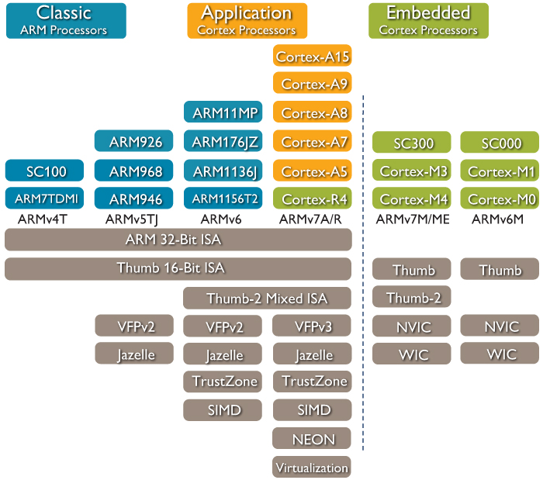
Which architecture is my processor?
Notes:
<number>

Slide 12
Agenda
Introduction
ARM Architecture Overview
ARMv7-AR Architecture
Programmer’s Model
Memory Systems
ARMv7-M Architecture
Programmer’s Model
Memory Systems
Floating Point Extensions
ARM System Design
Software Development Tools
Notes:
<number>

Slide 13
Architecture ARMv7-AR profiles
Application profile (ARMv7-A)
Memory management support (MMU)
Highest performance at low power
Influenced by multi-tasking OS system requirements
e.g. Cortex-A5, Cortex-A8, Cortex-A9, Cortex-A15
Real-time profile (ARMv7-R)
Protected memory (MPU)
Low latency and predictability ‘real-time’ needs
Evolutionary path for traditional embedded business
e.g. Cortex-R4, Cortex-R5

Slide 14
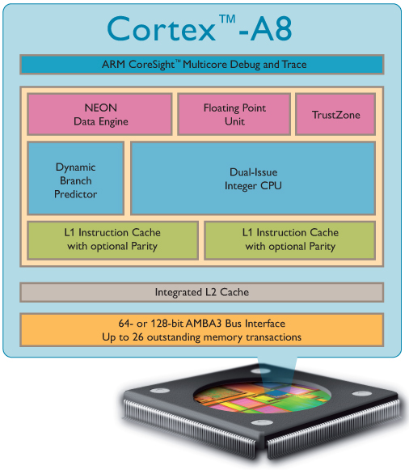
Cortex-A8
ARMv7-A Architecture
Thumb-2
Thumb-2EE (Jazelle-RCT)
TrustZone extensions
Custom or synthesized design
MMU
64-bit or 128-bit AXI Interface
L1 caches
16 or 32KB each
Unified L2 cache
0-2MB in size
8-way set-associative
Optional features
VFPv3 Vector Floating-Point
NEON media processing engine
Dual-issue, super-scalar 13-stage pipeline
Branch Prediction & Return Stack
NEON and VFP implemented at end of pipeline

Slide 15
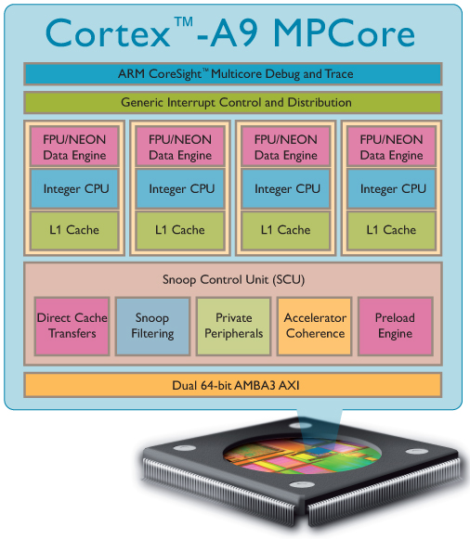
Cortex-A9
ARMv7-A Architecture
Thumb-2, Thumb-2EE
TrustZone support
Variable-length Multi-issue pipeline
Register renaming
Speculative data prefetching
Branch Prediction & Return
Stack
64-bit AXI instruction and data interfaces
TrustZone extensions
L1 Data and Instruction caches
16-64KB each
4-way set-associative
Optional features:
PTM instruction trace interface
IEM power saving support
Full Jazelle DBX support
VFPv3-D16 Floating-Point Unit (FPU) or NEON™ media processing engine

Slide 16

Cortex-A15 MPCore
1-4 processors per cluster
Fixed size L1 caches (32KB)
Integrated L2 Cache
512KB – 4MB
System-wide coherency support with AMBA 4 ACE
Backward-compatible with
AXI3 interconnect
Integrated Interrupt Controller
0-224 external interrupts for entire cluster
CoreSight debug
Advanced Power Management
Large Physical Address Extensions (LPAE) to ARMv7-A Architecture
Virtualization Extensions to ARMv7-A Architecture

Slide 17
Agenda
Introduction
ARM Architecture Overview
ARMv7-AR Architecture
Programmer’s Model
Memory Systems
ARMv7-M Architecture
Programmer’s Model
Memory Systems
Floating Point Extensions
ARM System Design
Software Development Tools
Notes:
<number>

Slide 18
Data Sizes and Instruction Sets
ARM is a 32-bit load / store RISC architecture
The only memory accesses allowed are loads and stores
Most internal registers are 32 bits wide
Most instructions execute in a single cycle
When used in relation to ARM cores
Halfword means 16 bits (two bytes)
Word means 32 bits (four bytes)
Doubleword means 64 bits (eight bytes)
ARM cores implement two basic instruction sets
ARM instruction set – instructions are all 32 bits long
Thumb instruction set – instructions are a mix of 16 and 32 bits
Thumb-2 technology added many extra 32- and 16-bit instructions to the original 16-bit Thumb instruction set
Depending on the core, may also implement other instruction sets
VFP instruction set – 32 bit (vector) floating point instructions
NEON instruction set – 32 bit SIMD instructions
Jazelle-DBX - provides acceleration for Java VMs (with additional software support)
Jazelle-RCT - provides support for interpreted languages

Slide 19
Processor Modes
ARM has seven basic operating modes
Each mode has access to its own stack space and a different subset of registers
Some operations can only be carried out in a privileged mode
Mode | Description
Supervisor (SVC) | Entered on reset and when a Supervisor call instruction (SVC) is executed | Privileged modes
FIQ | Entered when a high priority (fast) interrupt is raised
IRQ | Entered when a normal priority interrupt is raised
Abort | Used to handle memory access violations
Undef | Used to handle undefined instructions
System | Privileged mode using the same registers as User mode
User | Mode under which most Applications / OS tasks run | Unprivileged mode
Exception modes

Slide 20
The ARM Register Set
User mode
IRQ
FIQ
Undef
Abort
SVC
r0
r1
ARM has 37 registers, all 32-bits long
A subset of these registers is accessible in each mode
Note: System mode uses the User mode register set.
r2
r3
r4
r5
r6
r7
r8
r8
r9
r9
r10
r10
r11
r11
r12
r12
r13 (sp)
r13 (sp)
r13 (sp)
r13 (sp)
r13 (sp)
r13 (sp)
r14 (lr)
r14 (lr)
r14 (lr)
r14 (lr)
r14 (lr)
r14 (lr)
r15 (pc)
cpsr
spsr
spsr
spsr
spsr
spsr
Current mode
Banked out registers

Slide 21
Program Status Registers
31
28
27
24
23
19
16
15
10
9
8
7
6
5
4
0
N Z C V
Q
[de]
J
GE[3:0]
IT[abc]
E A
I F
T
mode
f
s
x
c
Condition code flags
N = Negative result from ALU
Z = Zero result from ALU
C = ALU operation Carried out
V = ALU operation oVerflowed
Sticky Overflow flag - Q flag
Indicates if saturation has occurred
SIMD Condition code bits – GE[3:0]
Used by some SIMD instructions
IF THEN status bits – IT[abcde]
Controls conditional execution of Thumb instructions
T bit
T = 0: Processor in ARM state
T = 1: Processor in Thumb state
J bit
J = 1: Processor in Jazelle state
Mode bits
Specify the processor mode
Interrupt Disable bits
I = 1: Disables IRQ
F = 1: Disables FIQ
E bit
E = 0: Data load/store is little endian
E = 1: Data load/store is bigendian
A bit
A = 1: Disable imprecise data aborts

Slide 22
Instruction Set basics
The ARM Architecture is a Load/Store architecture
No direct manipulation of memory contents
Memory must be loaded into the CPU to be modified, then written back out
Cores are either in ARM state or Thumb state
This determines which instruction set is being executed
An instruction must be executed to switch between states
The architecture allows programmers and compilation tools to reduce branching through the use of conditional execution
Method differs between ARM and Thumb, but the principle is that most (ARM) or all (Thumb) instructions can be executed conditionally.

Slide 23
Data Processing Instructions
These instructions operate on the contents of registers
They DO NOT affect memory
Syntax:
<Operation>{<cond>}{S} {Rd,} Rn, Operand2
Examples:
ADD r0, r1, r2 ; r0 = r1 + r2
TEQ r0, r1 ; if r0 = r1, Z flag will be set
MOV r0, r1 ; copy r1 to r0
 | arithmetic |  |  |  | logical |  | move
manipulation (has destination register) | ADD | ADC | SUB | SBC RSB RSC | AND | EOR | MOV
comparison (set flags only) | CMN (ADDS) |  | CMP (SUBS) |  | TST (ANDS) | TEQ (EORS)
BIC
ORR
MVN
ORN

Slide 24
Single Access Data Transfer
Use to move data between one or two registers and memory
LDRD STRD Doubleword
LDR STR Word
LDRB STRB Byte
LDRH STRH Halfword
LDRSB Signed byte load
LDRSH Signed halfword load
Syntax:
LDR{<size>}{<cond>} Rd, <address>
STR{<size>}{<cond>} Rd, <address>
Example:
LDRB r0, [r1] ; load bottom byte of r0 from the ; byte of memory at address in r1
Memory
31
0
Rd
Upper bits zero filled or
sign extended on Load

Slide 25
Multiple Register Data Transfer
These instructions move data between multiple registers and memory
Syntax
<LDM|STM>{<addressing_mode>}{<cond>} Rb{!}, <register list>
4 addressing modes
Increment after/before
Decrement after/before
Also
PUSH/POP, equivalent to STMDB/LDMIA with SP! as base register
Example
LDM r10, {r0,r1,r4} ; load registers, using r10 base
PUSH {r4-r6,pc} ; store registers, using SP base
(IA)
IB
DA
DB
r4
r4
r1
r1
r0
Increasing
Address
Base Register (Rb)
r10
r0
r4
r1
r4
r0
r1
r0

Slide 26
Subroutines
Implementing a conventional subroutine call requires two steps
Store the return address
Branch to the address of the required subroutine
These steps are carried out in one instruction, BL
The return address is stored in the link register (lr/r14)
Branch to an address (range dependent on instruction set and width)
Return is by branching to the address in lr
func1
func2
void func1 (void)
{
:
func2();
:
}
:
BL func2
:
:
BX lr

Slide 27
Supervisor Call (SVC)
SVC{<cond>} <SVC number>
Causes an SVC exception
The SVC handler can examine the SVC number to decide what operation has been requested
But the core ignores the SVC number
By using the SVC mechanism, an operating system can implement a set of privileged operations (system calls) which applications running in user mode can request
Thumb version is unconditional

Slide 28
Exception Handling
When an exception occurs, the core…
Copies CPSR into SPSR_<mode>
Sets appropriate CPSR bits
Change to ARM state (if appropriate)
Change to exception mode
Disable interrupts (if appropriate)
Stores the return address in LR_<mode>
Sets PC to vector address
To return, exception handler needs to…
Restore CPSR from SPSR_<mode>
Restore PC from LR_<mode>
Cores can enter ARM state or Thumb state when
taking an exception
Controlled through settings in CP15
Note that v7-M and v6-M exception model is different
0x1C
FIQ
0x18
IRQ
0x14
(Reserved)
0x10
Data Abort
0x0C
Prefetch Abort
0x08
Supervisor Call
0x04
Undefined Instruction
0x00
Reset
Vector Table
Vector table can also be at
0xFFFF0000 on most cores

Slide 29
Exception handling process
Save processor status
Copies CPSR into SPSR_<mode>
Stores the return address in LR_<mode>
Adjusts LR based on exception type
Change processor status for exception
Mode field bits
ARM or Thumb state
Interrupt disable bits (if appropriate)
Sets PC to vector address
Execute exception handler
<users code>
Return to main application
Restore CPSR from SPSR_<mode>
Restore PC from LR_<mode>
1 and 2 performed automatically by the core
3 and 4 responsibility of software
Main
Application
Save processor status
Change status
Exception
handler
Return from exception

Slide 30
What is NEON?
NEON is a wide SIMD data processing architecture
Extension of the ARM instruction set (v7-A)
32 x 64-bit wide registers (can also be used as 16 x 128-bit wide registers)
NEON instructions perform “Packed SIMD” processing
Registers are considered as vectors of elements of the same data type
Data types available: signed/unsigned 8-bit, 16-bit, 32-bit, 64-bit, single prec. float
Instructions usually perform the same operation in all lanes
Source Registers
Source Registers
Elements
Elements
Elements
Dn
Dm
Operation
Dd
Destination Register
Lane

Slide 31
NEON Coprocessor registers
NEON has a 256-byte register file
Separate from the core registers (r0-r15)
Extension to the VFPv2 register file (VFPv3)
Two different views of the NEON registers
32 x 64-bit registers (D0-D31)
16 x 128-bit registers (Q0-Q15)
Enables register trade-offs
Vector length can be variable
Different registers available
Q0
D0
D0
D1
Q1
D1
D2
D2
:
D3
:
D3
:
Q15
D30
D31

Slide 32
NEON vectorizing example
How does the compiler perform vectorization?
void add_int(int * __restrict pa,
int * __restrict pb,
unsigned int n, int x)
{
unsigned int i;
for(i = 0; i < (n & ~3); i++)
pa[i] = pb[i] + x;
}
2. Unroll the loop to the appropriate number of iterations, and perform other transformations like pointerization
void add_int(int *pa, int *pb,
unsigned n, int x)
{
unsigned int i;
for (i = ((n & ~3) >> 2); i; i--)
{
*(pa + 0) = *(pb + 0) + x;
*(pa + 1) = *(pb + 1) + x;
*(pa + 2) = *(pb + 2) + x;
*(pa + 3) = *(pb + 3) + x;
pa += 4; pb += 4;
}
}
1. Analyze each loop:
Are pointer accesses safe for vectorization?
What data types are being used?
How do they map onto NEON vector registers?
Number of loop iterations
pb
x
3. Map each unrolled operation onto a NEON vector lane, and generate corresponding NEON instructions
+
+
+
+
+
pa
127
0

Slide 33
Agenda
Introduction
ARM Architecture Overview
ARMv7-AR Architecture
Programmer’s Model
Memory Systems
ARMv7-M Architecture
Programmer’s Model
Memory Systems
Floating Point Extensions
ARM System Design
Software Development Tools
Notes:
<number>

Slide 34
Memory Types
Each defined memory region will specify a memory type
The memory type controls the following:
Memory access ordering rules
Caching and buffering behaviour
There are 3 mutually exclusive memory types:
Normal
Device
Strongly Ordered
Normal and Device memory allow additional attributes for specifying
The cache policy
Whether the region is Shared
Normal memory allows you to separately configure Inner and Outer cache policies (discussed in the Caches and TCMs module)

Slide 35
L1 and L2 Caches
I-Cache RAM
L2 Cache
Off-chip
Memory
MMU/MPU
ARM Core
On-chip
SRAM
BIU
D-Cache RAM
L1
L2
L3
Typical memory system can have multiple levels of cache
Level 1 memory system typically consists of L1-caches, MMU/MPU and TCMs
Level 2 memory system (and beyond) depends on the system design
Memory attributes determine cache behavior at different levels
Controlled by the MMU/MPU (discussed later)
Inner Cacheable attributes define memory access behavior in the L1 memory system
Outer Cacheable attributes define memory access behavior in the L2 memory system (if external) and beyond (as signals on the bus)
Before caches can be used, software setup must be performed

Slide 36
ARM Cache Features
Harvard Implementation for L1 caches
Separate Instruction and Data caches
Cache Lockdown
Prevents line Eviction from a specified Cache Way (discussed later)
Pseudo-random and Round-robin replacement strategies
Unused lines can be allocated before considering replacement
Non-blocking data cache
Cache Lookup can hit before a Linefill is complete (also checks Linefill buffer)
Streaming, Critical-Word-First
Cache data is forwarded to the core as soon as the requested word is received in the Linefill buffer
Any word in the cache line can be requested first using a ‘WRAP’ burst on the bus
ECC or parity checking

Slide 37
Example 32KB ARM cache
Address
Tag
Set (= Index)
Word
Byte
31 13 12 5 4 2 1 0
19
8
3
Cache line
7
6
5
4
3
2
1
0
d
Tag
v
Data
d
Tag
v
Data
d
Tag
v
Data
d
Cache has 8 words of data in each line
Each cache line contains Dirty bit(s)
Indicates whether a particular cache line was modified by the ARM core
Each cache line can be Valid or invalid
An invalid line is not considered when performing a Cache Lookup
Tag
v
Line 0
d
Data
Line 0
Line 1
Victim
Counter
Line 0
Line 1
Line 0
Line 1
Line 1
Line 254
Line 30
Line 255
Line 30
Line 31
Line 30
Line 31
Line 31
v - valid bit d - dirty bit(s)

Slide 38
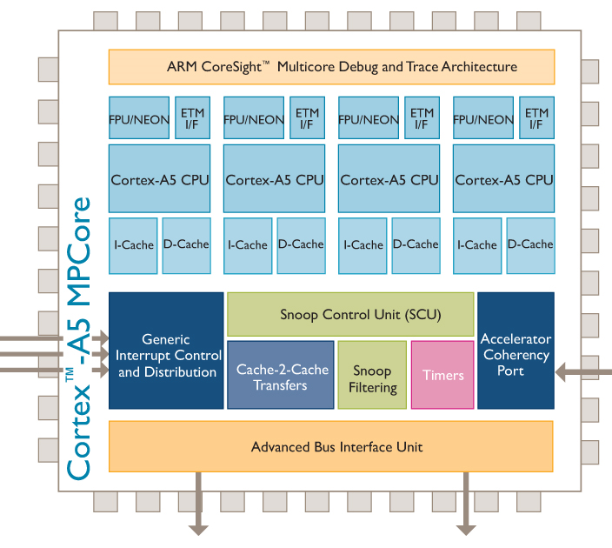
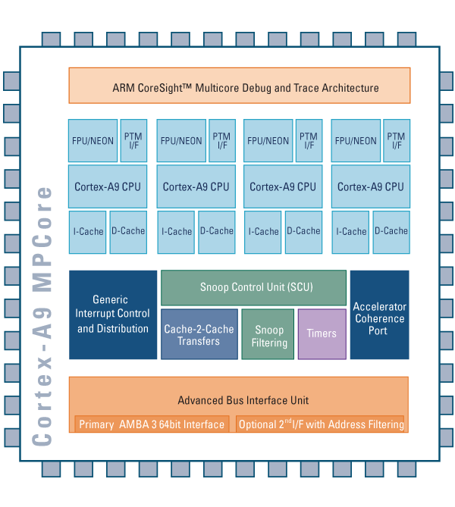
Cortex MPCore Processors
Standard Cortex cores, with additional logic to support MPCore
Available as 1-4 CPU variants
Include integrated
Interrupt controller
Snoop Control Unit (SCU)
Timers and Watchdogs
Notes:
<number>

Slide 39
Snoop Control Unit
The Snoop Control Unit (SCU) maintains coherency between L1 data caches
Duplicated Tag RAMs keep track of what data is allocated in each CPU’s cache
Separate interfaces into L1 data caches for coherency maintenance
Arbitrates accesses to L2 AXI master interface(s), for both instructions and data
Optionally, can use address filtering
Directing accesses to configured memory range to AXI Master port 1
AXI Master 0
AXI Master 1
Snoop Control Unit
TAG
TAG
TAG
TAG
D$
I$
D$
I$
D$
I$
D$
I$
CPU0
CPU1
CPU2
CPU3

Slide 40
Interrupt Controller
MPCore processors include an integrated Interrupt Controller (IC)
Implementation of the Generic Interrupt Controller (GIC) architecture
The IC provides:
Configurable number of external interrupts (max 224)
Interrupt prioritization and pre-emption
Interrupt routing to different cores
Enabled per CPU
When not enabled, that CPU will use legacy nIRQ[n] and nFIQ[n] signals
External Interrupt
Sources
Legacy IRQ and
FIQ Signals
.......
Interrupt Controller
nIRQ
nFIQ
Global
Timer
Private
Timer
CPU {n}
Private
Watchdog

Slide 41
Agenda
Introduction
ARM Architecture Overview
ARMv7-AR Architecture
Programmer’s Model
Memory Systems
ARMv7-M Architecture
Programmer’s Model
Memory Systems
Floating Point Extensions
ARM System Design
Software Development Tools
Notes:
<number>

Slide 42
ARMv7-M Profile Overview
v7-M Cores are designed to support the microcontroller market
Simpler to program – entire application can be programmed in C
Fewer features needed than in application processors
Register and ISA changes from other ARM cores
No ARM instruction set support
Only one set of registers
xPSR has different bits than CPSR
Different modes and exception models
Only two modes: Thread mode and Handler mode
Vector table is addresses, not instructions
Exceptions automatically save state (r0-r3, r12, lr, xPSR, pc) on the stack
Different system control/memory layout
Cores have a fixed memory map
No coprocessor 15 – controlled through memory mapped control registers

Slide 43
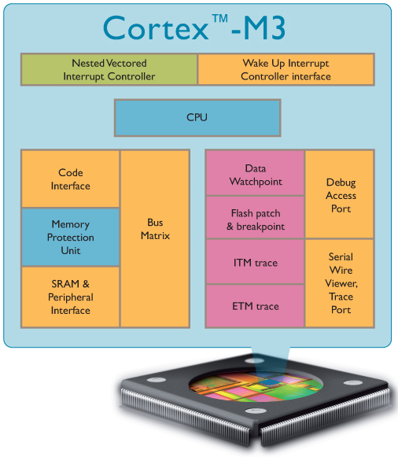
Cortex-M3
ARMv7-M Architecture
Thumb-2 only
Fully programmable in C
3-stage pipeline
von Neumann architecture
Optional MPU
AHB-Lite bus interface
Fixed memory map
1-240 interrupts
Configurable priority levels
Non-Maskable Interrupt support
Debug and Sleep control
Serial wire or JTAG debug
Optional ETM
Cortex M3 Total 60k* Gates

Slide 44
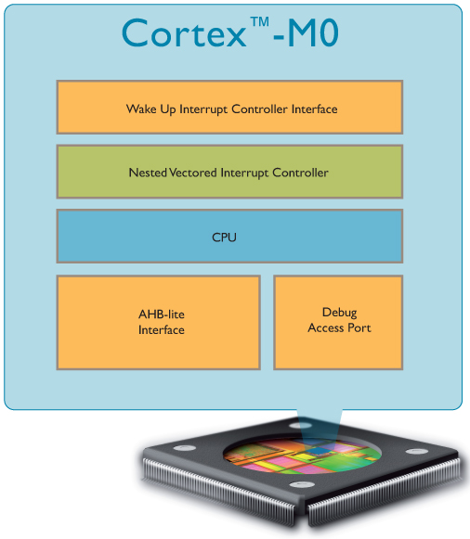
Cortex-M0
ARMv6-M Architecture
16-bit Thumb-2 with system control instructions
Fully programmable in C
3-stage pipeline
von Neuman architecture
AHB-Lite bus interface
Fixed memory map
1-32 interrupts
Configurable priority levels
Non-Maskable Interrupt support
Low power support
Core configured with or without debug
Variable number of watchpoints and breakpoints
Cortex M3 Total 60k* Gates

Slide 45
Agenda
Introduction
ARM Architecture Overview
ARMv7-AR Architecture
Programmer’s Model
Memory Systems
ARMv7-M Architecture
Programmer’s Model
Memory Systems
Floating Point Extensions
ARM System Design
Software Development Tools
Notes:
<number>

Slide 46
Processor Register Set
Registers R0-R12
General-purpose registers
R13 is the stack pointer (SP) - 2 banked versions
R14 is the link register (LR)
R15 is the program counter (PC)
PSR (Program Status Register)
Not explicitly accessible
Saved to the stack on an exception
Subsets available as APSR, IPSR, and EPSR
R0
R1
R2
R3
R4
R5
R6
R7
R8
R9
R10
R11
R12
R13 (SP)
R14 (LR)
R15 (PC)
PSR

Slide 47
Special Purpose Registers
Program Status Register
Described in upcoming slides
Special Purpose Mask Registers : PRIMASK, FAULTMASK, BASEPRI
Used to modify exception priorities
To set/clear PRIMASK and FAULTMASK, use CPS instructions
CPSIE i / CPSID i / CPSIE f / CPSID f
Special Purpose CONTROL Register
2 bits
Bit 0 defines Thread mode privilege
Bit 1 defines Thread mode stack
The Special Purpose Registers are not memory-mapped
Accessed via specific instructions
MRS – Move special purpose register to general-purpose register
MSR – Move general-purpose register to special purpose register

Slide 48
xPSR - Program Status Register
31
28
27
26
25
24
23
20
19
16
15
10
9
8
0
IT
T
GE[3:0]
IT/ICI
ISR Number
N Z C V Q
xPSR stored on stack during exceptions
Condition code flags
N = Negative result from ALU
Z = Zero result from ALU
C = ALU operation carry out
V = ALU operation overflow
Q = Saturated math overflow
IT/ICI bits
Contain IF-THEN base condition code or Interrupt Continue information
ISR Number
Stacked xPSR shows which exception was pre-empted
T=1

Slide 49
System Timer – SysTick
Flexible system timer
24-bit self-reloading down counter
Reload on count == 0
Optionally cause SysTick interrupt on count == 0
Reload register
Calibration value
Clock source is CPU clock or optional external timing reference
Software selectable if provided
Reference pulse widths High/Low must exceed processor clock period
Counted by sampling on processor clock
Calibration Register provides value required for 10ms interval
STCALIB inputs tied to appropriate value

Slide 50
Modes Overview
ARM Processor
Application Code
Thread
Mode
Reset
Exception
Entry
Exception
Return
Exception Code
Handler
Mode
Not shown: Handler mode can also be re-entered on exception return

Slide 51
Instruction Set Examples:
Data Processing:
MOV r2, r5 ; r2 = r5
ADD r5, #0x24 ; r5 = r5 + 36
ADD r2, r3, r4, LSL #2 ; r2 = r3 + (r4 * 4)
LSL r2, #3 ; r2 = r2 * 8
MOVT r9, #0x1234 ; upper halfword of r9 = #0x1234
MLA r0, r1, r2, r3 ; r0 = (r1 * r2) + r3
Memory Access:
STRB r2, [r10, r1] ; store lower byte in r2 at address {r10 + r1}
LDR r0, [r1, r2, LSL #2] ; load r0 with data at address {r1 + r2 * 4}
Program Flow:
BL <label> ; PC relative branch to <label> location, and return address stored in LR (r14)

Slide 52
Exception Handling
Exception types:
Reset
Non-maskable Interrupts (NMI)
Faults
PendSV
SVCall
External Interrupt
SysTick Interrupt
Exceptions processed in Handler mode (except Reset)
Exceptions always run privileged
Interrupt handling
Interrupts are a sub-class of exception
Automatic save and restore of processor registers (xPSR, PC, LR, R12, R3-R0)
Allows handler to be written entirely in ‘C’

Slide 53
External Interrupts
External Interrupts handled by Nested Vectored Interrupt Controller (NVIC)
Tightly coupled with processor core
One Non-Maskable Interrupt (NMI) supported
Number of external interrupts is implementation-defined
ARMv7-M supports up to 496 interrupts
INTNMI
NVIC
Cortex-Mx
Processor Core
INTISR[0]
…
…
INTISR[N]
……
Cortex-Mx Integration Layer

Slide 54
Exception Handling Example
Higher Priority
IRQ1
IRQ2
IRQ3
Base CPU
Time
Core Execution
Foreground
ISR2
ISR1
ISR2
ISR3
Foreground
(ISR 2 resumes)

Slide 55
Vector Table for ARMv7-M
First entry contains initial Main SP
All other entries are addresses for exception handlers
Must always have LSBit = 1 (for Thumb)
Table has up to 496 external interrupts
Implementation-defined
Maximum table size is 2048 bytes
Table may be relocated
Use Vector Table Offset Register
Still require minimal table entries at 0x0 for booting the core
Each exception has a vector number
Used in Interrupt Control and State Register to indicate the active or pending exception type
Table can be generated using C code
Example provided later
Address
Vector #
0x40 + 4*N
External N
16 + N
…
…
…
0x40
External 0
16
0x3C
SysTick
15
0x38
PendSV
14
0x34
Reserved
13
0x30
Debug Monitor
12
0x2C
SVC
11
0x1C to 0x28
Reserved (x4)
7-10
0x18
Usage Fault
6
0x14
Bus Fault
5
0x10
Mem Manage Fault
4
0x0C
Hard Fault
3
0x08
NMI
2
0x04
Reset
1
0x00
Initial Main SP
N/A

Slide 56
Reset Behavior
Main
5
4
Reset Handler
0x04
0x00
3
Reset Handler Vector
1
Initial value of MSP
r13 (MSP)
2
A reset occurs (Reset input was asserted)
Load MSP (Main Stack Pointer) register initial value from address 0x00
Load reset handler vector address from address 0x04
Reset handler executes in Thread Mode
Optional: Reset handler branches to the main program
Notes:
<number>

Slide 57
Exception Behaviour
1
Main
4
3
Exception Handler
2
Exception Vector
Exception occurs
Current instruction stream stops
Processor accesses vector table
Vector address for the exception loaded from the vector table
Exception handler executes in Handler Mode
Exception handler returns to main
Notes:
<number>

Slide 58
Interrupt Service Routine Entry
When receiving an interrupt the processor will finish the current instruction for most instructions
To minimize interrupt latency, the processor can take an interrupt during the execution of a multi-cycle instruction - see next slide
Processor state automatically saved to the current stack
8 registers are pushed: PC, R0-R3, R12, LR, xPSR
Follows ARM Architecture Procedure Calling Standard (AAPCS)
During (or after) state saving the address of the ISR is read from the Vector Table
Link Register is modified for interrupt return
First instruction of ISR executed
For Cortex-M3 or Cortex-M4 the total latency is normally 12 cycles, however, interrupt late-arrival and interrupt tail-chaining can improve IRQ latency
ISR executes from Handler mode with Main stack

Slide 59
Returning From Interrupt
Can return from interrupt with the following instructions when the PC is loaded with “magic” value of 0xFFFF_FFFX (same format as EXC_RETURN)
LDR PC, …..
LDM/POP which includes loading the PC
BX LR (most common)
If no interrupts are pending, foreground state is restored
Stack and state specified by EXC_RETURN is used
Context restore on Cortex-M3 and Cortex-M4 requires 10 cycles
If other interrupts are pending, the highest priority may be serviced
Serviced if interrupt priority is higher than the foreground’s base priority
Process is called Tail-Chaining as foreground state is not yet restored
Latency for servicing new interrupt is only 6 cycles on M3/M4 (state already saved)
If state restore is interrupted, it is abandoned
New ISR executed without state saving (original state still intact and valid)
Must still fetch new vector and refill pipeline (6-cycle latency on M3/M4)

Slide 60
Vector Table in C
typedef void(* const ExecFuncPtr)(void) __irq;
#pragma arm section rodata="exceptions_area”
ExecFuncPtr exception_table[] = {
(ExecFuncPtr)&Image$$ARM_LIB_STACK$$ZI$$Limit, /* Initial SP */
(ExecFuncPtr)__main, /* Initial PC */
NMIException,
HardFaultException,
MemManageException,
BusFaultException,
UsageFaultException,
0, 0, 0, 0, /* Reserved */
SVCHandler,
DebugMonitor,
0, /* Reserved */
PendSVC,
SysTickHandler
/* Configurable interrupts start here...*/
};
#pragma arm section
The vector table at address 0x0 is minimally required to have 4 values: stack top,
reset routine location,
NMI ISR location,
HardFault ISR location
The SVCall ISR location must be populated if the SVC instruction will be used
Once interrupts are enabled, the vector table (whether at 0 or in SRAM) must then have pointers to all enabled (by mask) exceptions

Slide 61
Vector Table in Assembly
PRESERVE8
THUMB
IMPORT ||Image$$ARM_LIB_STACK$$ZI$$Limit||
AREA RESET, DATA, READONLY
EXPORT __Vectors
__Vectors DCD ||Image$$ARM_LIB_STACK$$ZI$$Limit|| ; Top of Stack
DCD Reset_Handler ; Reset Handler
DCD NMI_Handler ; NMI Handler
DCD HardFault_Handler ; Hard Fault Handler
DCD MemManage_Handler ; MemManage Fault Handler
DCD BusFault_Handler ; Bus Fault Handler
DCD UsageFault_Handler ; Usage Fault Handler
DCD 0, 0, 0, 0, ; Reserved x4
DCD SVC_Handler, ; SVCall Handler
DCD Debug_Monitor ; Debug Monitor Handler
DCD 0 ; Reserved
DCD PendSV_Handler ; PendSV Handler
DCD SysTick_Handler ; SysTick Handler
; External vectors start here

Slide 62
Agenda
Introduction
ARM Architecture Overview
ARMv7-AR Architecture
Programmer’s Model
Memory Systems
ARMv7-M Architecture
Programmer’s Model
Memory Systems
Floating Point Extensions
ARM System Design
Software Development Tools
Notes:
<number>

Slide 63
Processor Memory Map
External Private Peripheral Bus
E00F_FFFF
ROM Table
E00F_F000
UNUSED
FFFF_FFFF
E004_2000
ETM
512MB
System
(XN)
E004_1000
TPIU
E000_0000
E004_0000
1GB
External Peripheral
E003_FFFF
RESERVED
E000_F000
NVIC
E000_E000
A000_0000
RESERVED
E000_3000
FPB
External SRAM
E000_2000
DWT
1 GB
E000_1000
ITM
E000_0000
6000_0000
Internal Private Peripheral Bus
512MB
Peripheral
4000_0000
512MB
SRAM
2000_0000
512MB
Code
0000_0000

Slide 64
Memory Types and Properties
There are 3 different memory types:
Normal, Device and Strongly Ordered
Normal memory is the most flexible memory type:
Suitable for different types of memory, for example, ROM, RAM, Flash and SDRAM
Accesses may be restarted
Caches and Write Buffers are permitted to work alongside Normal memory
Device memory is suitable for peripherals and I/O devices
Caches are not permitted, but write buffers are still supported
Unaligned accesses are unpredictable
Accesses must not be restarted
Load/store multiple instructions should not be used to access Device memory
Strongly ordered memory is similar to Device memory
Buffers are not supported and the PPB is marked Strongly Ordered

Slide 65
System Control Block
Memory mapped space containing registers to configure, control, and deal with interrupts, exceptions, and debug
Replaces co-processor #15 in older ARM cores
Address
Type
Reset Value
Function
0xE000E000
Read/Write
0x00000000
Master Control register - RESERVED
0xE000E004
Read Only
IMP DEFINED
Interrupt Controller Type Register
0xE000ED00
Read Only
IMP DEFINED
CPUID Base Register
0xE000ED04
Read/Write
0x00000000
Interrupt Control State Register
0xE000ED08
Read/Write
0x00000000
Vector Table Offset Register
0xE000ED0C
Read/Write
Bits[10:8] = 000
Application Interrupt/Reset Control Register

Slide 66
More SCB Registers
Address
Type
Reset Value
Function
0xE000ED10
Read/Write
0x00000000
System Control Register
0xE000ED14
Read/Write
0x00000000
Configuration Control Register
0xE000ED18
Read/Write
0x00000000
System Handlers 4-7 Priority Register
0xE000ED1C
Read/Write
0x00000000
System Handlers 8-11 Priority Register
0xE000ED20
Read/Write
0x00000000
System Handlers 12-15 Priority Register
0xE000ED24
Read/Write
0x00000000
System Handler Control and State Register
0xE000ED28
Read/Write
n/a - status
Configurable Fault Status Registers (3)
0xE000ED2C
Read/Write
n/a - status
HardFault Status Register
0xE000ED30
Read/Write
n/a - status
DebugFault Status Register
0xE000ED34
Read/Write
Unpredictable
MemManage Address Register
0xE000ED38
Read/Write
Unpredictable
BusFault Address Register
0xE000ED3C
Read/Write
Unpredictable
Auxiliary Fault Status Register (vendor specific)
0xE000EF00
Write Only
Software Trigger Interrupt Register

Slide 67
Agenda
Introduction
ARM Architecture Overview
ARMv7-AR Architecture
Programmer’s Model
Memory Systems
ARMv7-M Architecture
Programmer’s Model
Memory Systems
Floating Point Extensions
ARM System Design
Software Development Tools
Notes:
<number>

Slide 68
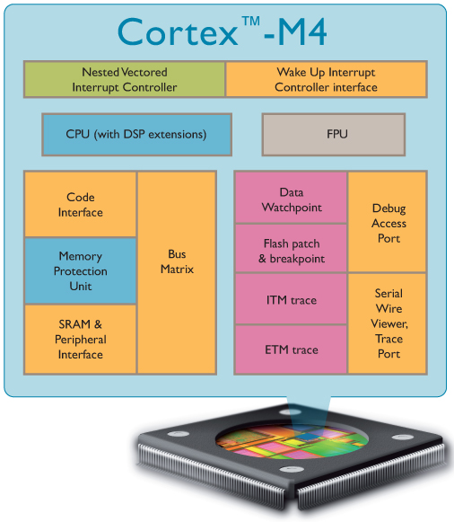
Cortex-M4
ARMv7E-M Architecture
Thumb-2 only
DSP extensions
Optional FPU (Cortex-M4F)
Otherwise, same as Cortex-M3
Implements full Thumb-2 instruction set
Saturated math (e.g. QADD)
Packing and unpacking (e.g. UXTB)
Signed multiply (e.g. SMULTB)
SIMD (e.g. ADD8)
Cortex M3 Total 60k* Gates

Slide 69
Cortex-M4F Floating Point Registers
FPU provides a further 32 single-precision registers
Can be viewed as either
32 x 32-bit registers
16 x 64-bit doubleword registers
Any combination of the above
S0
D0
S1
S2
D1
S3
S4
D2
S5
S6
D3
S7
~
~
~
~
~
~
~
~
S28
D14
S29
S30
D15
S31
Notes:
<number>

Slide 70
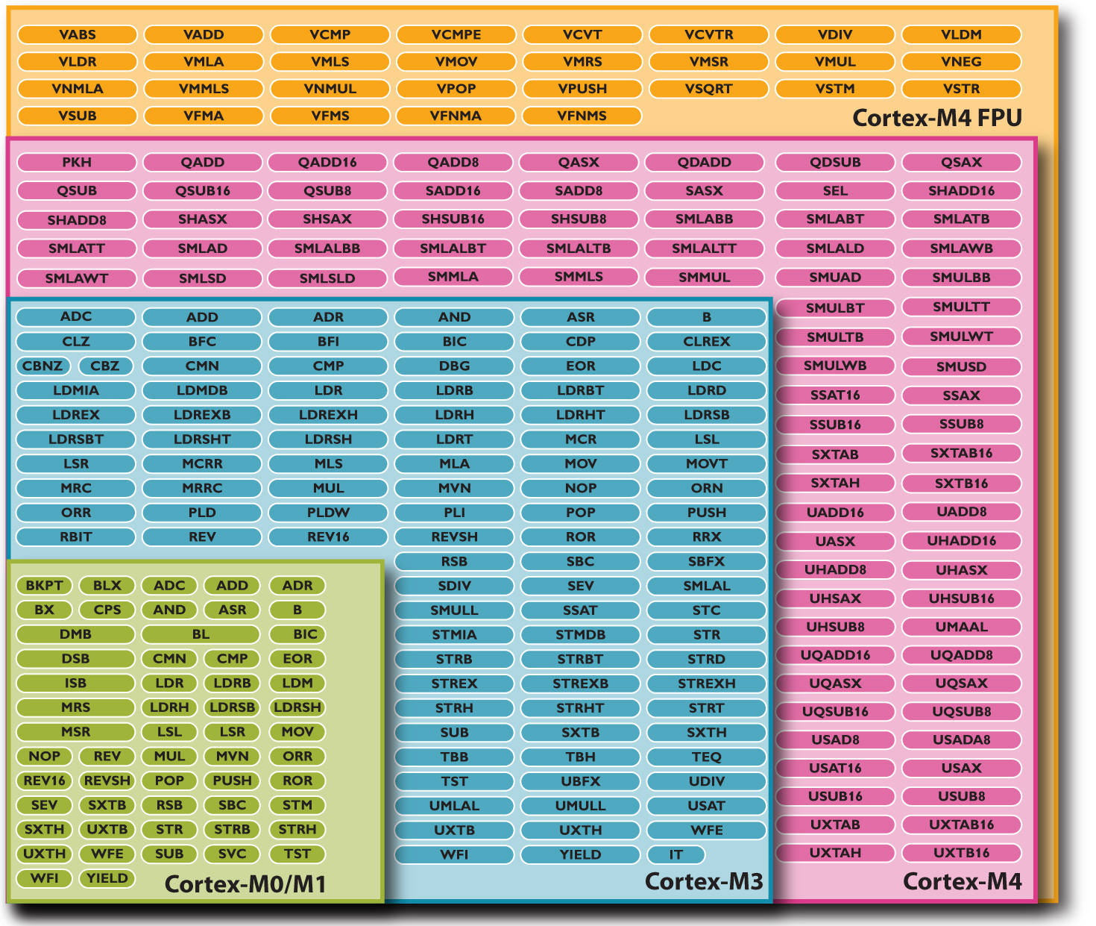
Binary Upwards Compatibility
ARMv7-M
Architecture
ARMv6-M
Architecture

Slide 71
Agenda
Introduction
ARM Architecture Overview
ARMv7-AR Architecture
Programmer’s Model
Memory Systems
ARMv7-M Architecture
Programmer’s Model
Memory Systems
Floating Point Extensions
ARM System Design
Software Development Tools
Notes:
<number>

Slide 72
Example ARM-based system
ARM core deeply embedded within an SoC
External debug and trace via JTAG or CoreSight interface
Design can have both external and internal memories
Varying width, speed and size – depending on system requirements
Can include ARM licensed CoreLink peripherals
Interrupt controller, since core only has two interrupt sources
Other peripherals and interfaces
Can include on-chip memory from ARM Artisan Physical IP Libraries
Elements connected using AMBA (Advanced Microcontroller Bus Architecture)
Clocks and
Reset Controller
DMA
Port
ARM
Processor core
FLASH
External
Memory Interface
AMBA AXI
DEBUG
nIRQ
nFIQ
SDRAM
On chip
memory
CoreLink Interrupt
Controller
APB
Bridge
Other
CoreLink Peripherals
AMBA APB
Custom Peripherals
ARM based SoC

Slide 73
An Example AMBA System
High Performance
ARM processor
APB
UART
High
Bandwidth
External
Memory
Interface
APB
Bridge
Timer
AHB
Keypad
High-bandwidth
on-chip RAM
DMA
Bus Master
PIO
Low Power
Non-pipelined
Simple Interface
High Performance
Pipelined
Burst Support
Multiple Bus Masters

Slide 74
AHB Structure
Arbiter
HADDR
Master
#1
HADDR
HWDATA
Slave
#1
HWDATA
HRDATA
HRDATA
Address/Control
Slave
#2
Master
#2
Write Data
Slave
#3
Read Data
Master
#3
Slave
#4
Decoder

Slide 75
AXI Multi-Master System Design
ARM
Master 2
Inter-connection architecture
Slave
#1
Slave
#2
Slave
#3
Slave
#4
Master interface
Slave interface

Slide 76
Agenda
Introduction
ARM Architecture Overview
ARMv7-AR Architecture
Programmer’s Model
Memory Systems
ARMv7-M Architecture
Programmer’s Model
Memory Systems
Floating Point Extensions
ARM System Design
Software Development Tools
Notes:
<number>

Slide 77

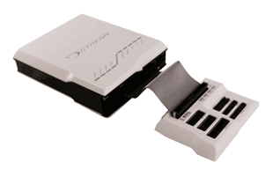
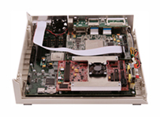
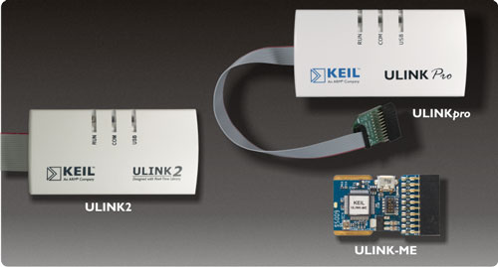
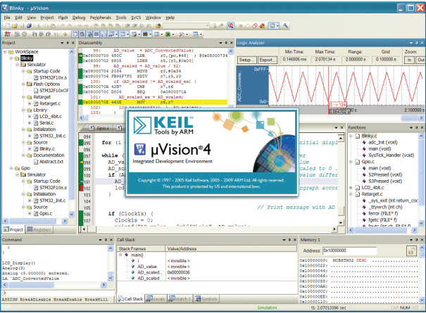
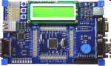
ARM Software Development Tools
Software Tools
DS-5
Application Edition
Linux Edition
Professional Edition
JTAG Debug and Trace
DSTREAM
Development Platforms
Fast Models
Versatile Platform baseboards
MDK: Keil Microcontroller Development Kit
ULINK
Keil MCU development boards
Keil µVision simulator

Slide 78
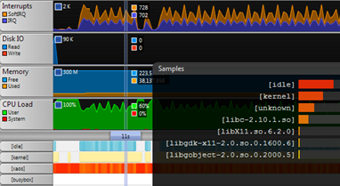
DS-5 Professional at a Glance
Integrated solution, professionally supported and maintained
End-to-end development, from SoC bring-up to application debug
Powerful ARM compiler
Best code size and performance
Intuitive DS-5 debugger
Flexible graphical user interface
DSTREAM probe with 4GB trace buffer
Fast SoC simulation models
Develop in a controlled environment
Examples and applications
Streamline performance analyzer
System-wide analysis of Linux
and Android systems
DS-5
Eclipse
Compiler
IDE
Debugger
Streamline
Device Configuration Database
Simulation
Hardware Debug
Notes:
<number>

Slide 79
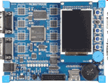
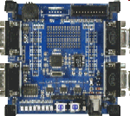
Development Suite: MDK
Low cost tools for ARM7, ARM9, Cortex-M and Cortex-R4 MCUs
Extensive device support for many devices
Core and peripheral simulation
Flash support
Microcontroller Development Kit (MDK)
IDE, optimized run-time library, KEIL RTX RTOS
ARM Compiler
Realtime trace (for Cortex-M3 and Cortex-M4 based devices)
Real-Time Library
KEIL RTX RTOS + Source Code
TCP networking suit, Flash File System, CAN Driver Library, USB Device Interface
Debug Hardware
Evaluation boards
Separate support channel
See www.keil.com

Slide 80

GNU Tools and Linux
GNU/GCC Tools Support
ARM works with CodeSourcery to keep the GNU toolchain current with the latest ARM processors
Linux Support
Pre-built Linux images are available for ARM hardware platforms
DS-5 accepts kernel images built with the GNU toolchain
Can also debug applications or loadable kernel modules
RVCT can be used to build Linux applications or libraries
Giving performance benefits
ARM does not provide technical support for the GNU toolchain, or Linux kernel/driver development

Slide 81
ARM University
Program
August 2012
Notes:
<number>

